Slide 1
Cluster Crossovers with Multiple periods
Shun Fu Lee PhD, Shrikant I Bangdiwala PhD, ​
Jessica Spence MD
Population Health Research Institute, Hamilton Health Sciences and McMaster University, Hamilton, Ontario, Canada
SCT 2019, New Orleans

Slide 2
Benzodiazepine-free Cardiac Anesthesia for Reduction in postoperative delirium (B-Free) trial.
Benzodiazepines: to ensure hemodynamic stability and prevent intraoperative awareness during cardiac surgery.
Delirium: serious problem affects 15-30% patients after cardiac surgery.
Acute confusional state associated prolonged length of stay
Institutional discharge
Functional decline
Cognitive decline
Death
Hypothesis: Need to establish whether the routine or restricted use of benzodiazepines in cardiac anesthesia affected the incidence of postoperative delirium.
Spence et al, 2018
Notes:
Benzodiapine known is commonly used as an anesthesia for the patients received cardiac surgery. However, individual RCT conducted in ICU showed that benzo has associated with an increased risk of delirium.
There is a wide variability in approach across individual practitioners because of the limited evidence based for best practice. Therefore, the practice guideline is base on expert opinion. The goal of the B-free study is to establish the routine or restricted use of benzo in cardiac anesthesia affected incidence of post-operative delirium.

Slide 3
Randomized-controlled trials (RCT)
Individual patients RCT
Better suited to provide evidence of efficacy.
Lack of generalizability unless for a large sample size.
Patient consent required.
Cluster RCT
To evaluate the effectiveness (true benefit to all patients in routine).
Account for the influences of patient-, provider-, and system-level factors
Possible individual consent waiver for interventions associated with a minimal risk and clearly demonstrated a clinical equipoise.
Notes:
Individual randomized clinical trials is better suited to test the clinical efficacy of an intervention limited to a specific population and under a conduct of an ideal setting. As results, it may be lack of generalizability unless for a large sample size. It is required to obtain patient consent.
A cluster randomized clinical trial is to evaluate the effectiveness of the intervention in a given setting which accounts for the influences of . A waiver of the consent can be obtained if the intervention poses a minimal risk.

Slide 4
Cluster Crossover RCT
a) Parallel Cluster RCT
Statistical less efficient: similar responses within cluster, measured by intra-cluster correlation (ICC).
Regain some statistical power by crossovers with each cluster acts its own control (inter-period correlation (IPC).
b) 2-Periods Cluster Crossover RCT
c) 4-Periods Cluster Crossover RCT
Notes:
However, it is known that cluster RCT is statistical less efficient because patients within a hospital may have more similar outcomes than those between hospitals , measured by intra-cluster correlation (ICC).
Regain some statistical power by crossover from one intervention arm to the other one or more times. Each cluster acts its own control group.
The objective is to examine

Slide 5
Objective
To examine and assess the effect of increasing the number of crossovers in cluster crossover randomized clinical trials.

Slide 6

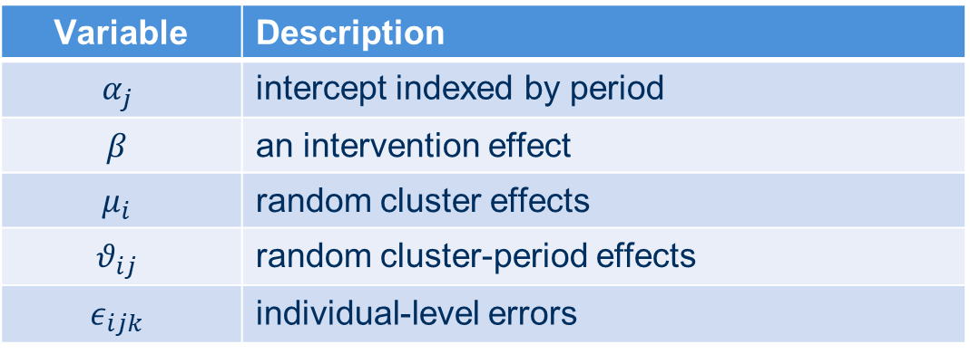
Model with cluster effects treated as random
Let $y_{ijk}$ be a binary outcome: $Y_{ijk}$=1 : event of interest; $Y_{ijk}$=0 : otherwise.
$$y_{ijk}=α_{j}+βx_{ij}+ μ_{i}+θ_{ij}+ε_{ijk}$$
$μ_{i} \sim N\left(0,σ_{μ}^{2}\right), θ_{ij} \sim N\left(0,σ_{θ}^{2}\right),$ $ε_{ijk} \sim N\left(0,σ_{ε}^{2}\right)$ independently
Variable | Description
$$α_{j}$$ | intercept indexed by period
$$β$$ | an intervention effect
$$μ_{i}$$ | random cluster effects
$$θ_{ij}$$ | random cluster-period effects
$$ε_{ijk}$$ | individual-level errors
Notes:
Here is the structure of a random effect model with the binary outcome yijk.
-intervention:
-cluster effect
-cluster-period

Slide 7
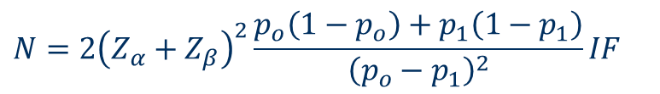
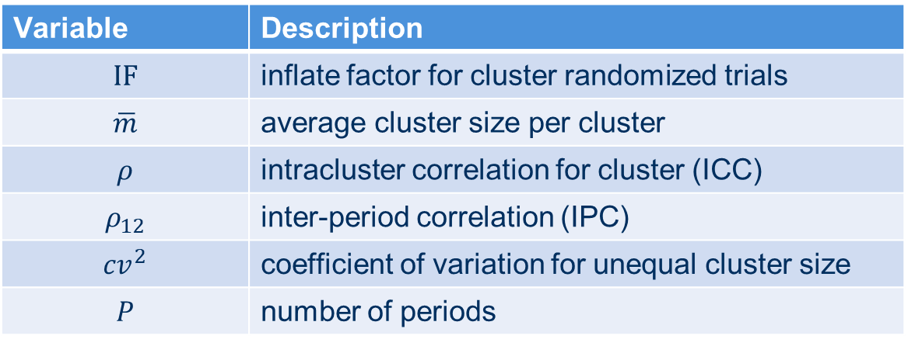
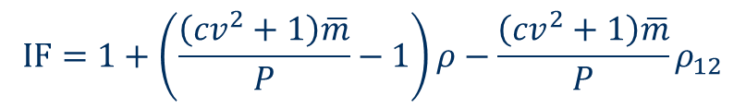
Sample size formula using a design effect
$$N={2\left(Z_{α}+Z_{β}\right)}^{2}\frac{p_{o}\left(1−p_{o}\right)+p_{1}\left(1−p_{1}\right)}{{\left(p_{o}−p_{1}\right)}^{2}}IF$$
$$IF=1+\left(\frac{\left({cv}^{2}+1\right)\overline{m}}{P}−1\right)ρ−\frac{\left({cv}^{2}+1\right)\overline{m}}{P}ρ_{12}$$
Variable | Description
$$IF$$ | inflate factor for cluster randomized trials
$$\overline{m}$$ | average cluster size per cluster
$$ρ$$ | intracluster correlation for cluster (ICC)
$$ρ_{12}$$ | inter-period correlation (IPC)
$${cv}^{2}$$ | coefficient of variation for unequal cluster size
$$P$$ | number of periods

Slide 8
Simulation Parameters
Parameters | Values
Fixed ICC | 0.05
Fixed IPC | Half of ICC
Odds ratio | 0.85 and 1.00
Control Event Rate | 0.15
Number of clusters | 4, 6, 12, 18, 24
Number of patients per cluster (m) | 400, 800, 1200
Number of periods (P) | 2, 4, 8, 12, 16
Coefficient of variation for unequal cluster sizes | 0.65
Replicates | 1000
Analyzed using GLIMMIX for cluster, cluster-period as random effects.

Slide 9
Simulation Results: Power
a) Fixed on 12 clusters
b) Fixed on cluster size of 800
Notes:
a)Examine different cluster sizes by fixing on 12 clusters and b) examine effect of number of clusters by fixing on each cluster with 800 patients.
Large slope observed for less than 8 periods for increasing from 20% with 2 periods to 50% with 8 periods and a light power gain with a large cluster size.
Similar with larger slope observed less than 8 periods for larger clusters (>= 12 clusters). A sample size of 24 clusters each 800 would have a power of 80% with 8 periods as compared to 30% with 2 periods.
More power gain by increasing number of clusters instead of cluster size.

Slide 10
Simulation Results: Type I error
a) Fixed on 12 clusters
b) Fixed on cluster size of 800
Notes:
Inflated type I error with 2 periods but maintained at 5% with more than 4 periods for 12 clusters.
In scenarios with a small number of clusters (e.g. 6 clusters), 5% type I error could be obtained with more than 8 periods.

Slide 11
Sample size for B-free trial
Assumed a type I error of 5% and a power of 80%.
IPC is assumed half of ICC with a coefficient of variation of 0.63.
Cluster Size | Relative Reduction | Control Event Rate | ICC | Number of periods | Inflation factor | Total N | Number of clusters
1000 | 0.15 | 0.15 | 0.02 | 2 | 7.96 | 59009 | 60
1000 | 0.15 | 0.15 | 0.02 | 4 | 4.47 | 33135 | 34
1000 | 0.15 | 0.15 | 0.02 | 8 | 2.73 | 20198 | 21
1000 | 0.15 | 0.15 | 0.02 | 12 | 2.14 | 15886 | 16
1000 | 0.15 | 0.15 | 0.02 | 16 | 1.85 | 13730 | 14
Sites will be randomized to twelve, 4-week crossover periods, blocking in periods of 2 to minimize period effects.

Slide 12
Summary
Significant power gain for cluster crossovers with multiple periods.
Larger increase in power with less than 8 periods and small increase with more than 8 periods.
More power gain by increasing number of clusters instead of cluster size.
Increase Type I error for a small number of clusters but may be reduced to a reasonable 5% with multiple periods.

Slide 13
References
Spence J, Belley-Côté, Lee SF, et al. The role of randomized cluster crossover trials for comparative effectiveness testing in anesthesia: design of the Benzodiazepine-Free Cardiac Anesthesia for Reduction in Postoperative Delirium (B-Free) trial. Can J Anesth 2018; 65: 813-21.
Hooper R, Bourke L. Cluster randomised trials with repeated cross sections: alternatives to parallel group designs. BMJ. 2015;350:h2925.
Giraudeau B, Ravaud P, Donner A. Sample size calculation for cluster randomized cross-over trials. Stat Med. 2008 Nov 29;27(27):5578-85.
Connolly SJ, Philippon F, Longtin Y, Casanova A, Birnie DH, Exner DV, Dorian P, Prakash R, Alings M, Krahn AD. Randomized cluster crossover trials for reliable, efficient, comparative effectiveness testing: design of the Prevention of Arrhythmia Device Infection Trial (PADIT). Can J Cardiol. 2013 Jun;29(6):652-8.
Forbes AB, Akram M, Pilcher D, Cooper J, Bellomo R. Cluster randomised crossover trials with binary data and unbalanced cluster sizes: application to studies of near-universal interventions in intensive care. Clin Trials 12(1):34-44.
Turner RM, White IR, Croudace T; PIP Study Group. Analysis of cluster randomized cross-over trial data: a comparison of methods. Stat Med. 2007;26(2):274-89.
Barker D, D’Este C, Campbell MJ, McElduff P. Minimum number of clusters and comparison of analysis methods for cross sectional stepped wedge cluster randomised trials with binary outcomes: A simulation study. Trials 201718:119.

Slide 14
Questions?

Slide 15
Power for B-free study with 16 clusters.
Notes:
Power was computed based on the sample size formula to look the effect of ICC on periods.
Larger slope

